Slide 1
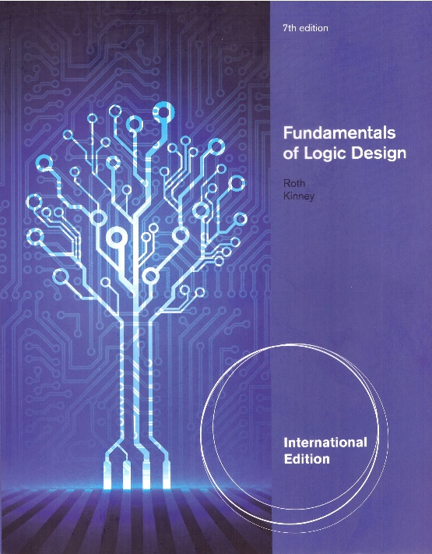
Unit 13
Analysis of Clocked Sequential Circuit
This chapter in the book includes:
Objectives
13.1 A Sequential Parity Checker .
13.2 Analysis by Signal Tracing
13.3 State Table and Graphs
13.4 General Models for Sequential Circuits

Slide 2
Objectives
Topics introduced in this chapter:
1 Analyze a sequential circuit by signal tracing
2 Given a sequential circuit, write the next-state equations for the flip-flops and
derive the state graph or state table. Using the state graph, determine the
state sequence and output sequence for a given input sequence
3 Explain the difference between a Mealy machine and a Moore machine
4 Given a state table, construct the corresponding state graph, and conversely
5 Given a sequential circuit or a state table and an input sequence, draw
a timing chart for the circuit. Determine the output sequence from the timing
chart, neglecting any false outputs
6 Draw a general model for a clocked Mealy or Moore sequential circuit.
Explain the operation of the circuit in terms of these models
Explain why a clock is needed to ensure proper operation of the circuit

Slide 3
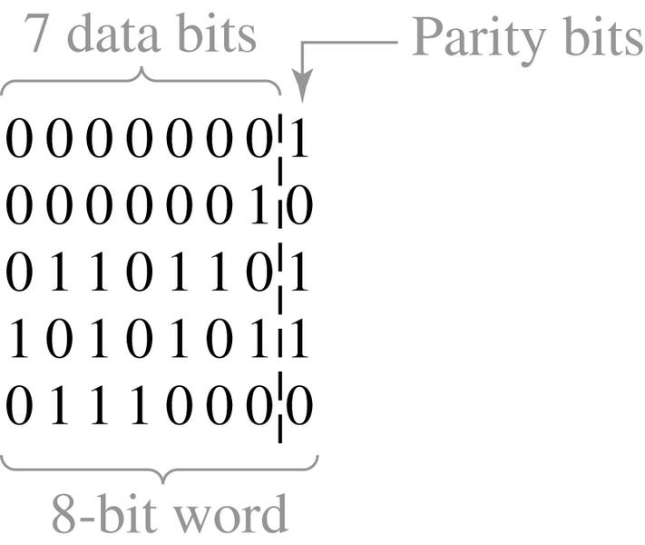
13.1 A Sequential Parity Checker
ASCII: 7-bit code
26 uppercase letters (‘A’ ~ ‘Z’)
26 lowercase letters (‘a’ ~ ‘z’)
10 numerals (‘0’ ~ ‘9’)
32 special printable characters (‘%’, ‘$’, …)
34 control characters (BS, CR, LF, …)
8-bit word with odd/even parity
Decided in sender
Data
transmission
line
Sender/
source
Receiver/
destination

Slide 4
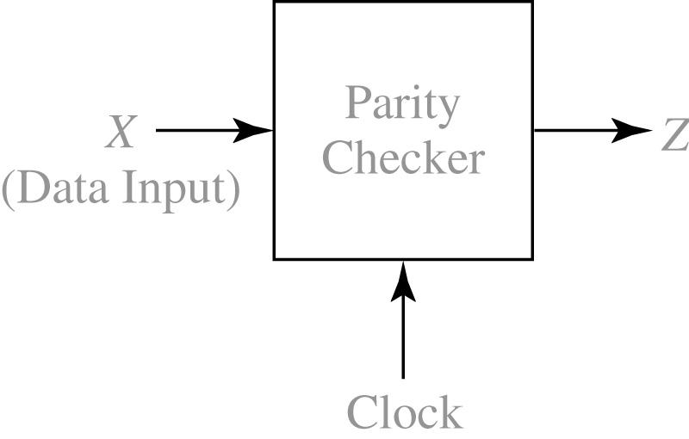
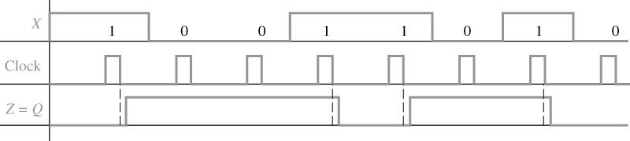
13.1 A Sequential Parity Checker
Fig 13-1. Block Diagram for Parity Checker (receiver side)
Z = 1 : the number of 1’s is odd
Z = 0 : transmission error
Figure 13-2: Waveforms for Parity Checker

Slide 5
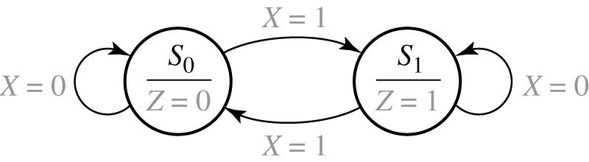
13.1 A Sequential Parity Checker
Figure 13-3: State Graph for Parity Checker (Moore Machine)
input
Output associated with the state
In a Moore machine is a finite state machine whose output values are determined solely by its current state - STABLE.
In a Mealy machine, whose output values are determined both by its current state and by the values of its inputs - FAST.
Reference 1: Moore E. F. Gedanken-experiments on Sequential Machines. Automata Studies, Annals of Mathematical Studies, 34, 129-153. Princeton University Press, Princeton, N.J.(1956)
Reference 2: Mealy, George H. A Method to Synthesizing Sequential Circuits. Bell System Technical Journal. pp. 1045-1079 (1955)

Slide 6
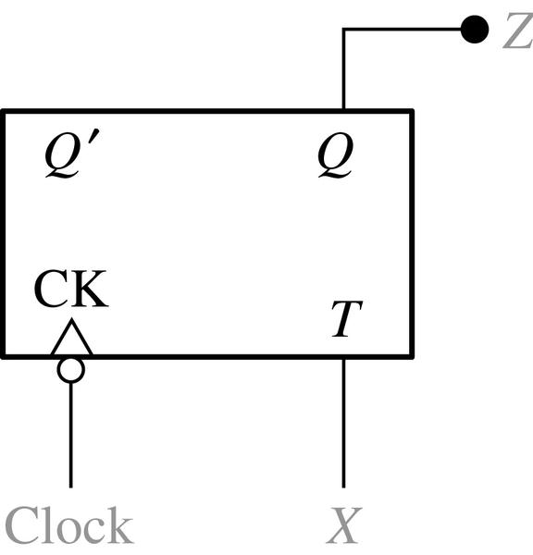
13.1 A Sequential Parity Checker
Table 13-1. State Table for Parity Checker
Present
State
Next state
Present
Output
Z
(a)
(b)
Figure 13-4: Parity Checker

Slide 7
13.2 Analysis by Signal Tracing and Timing Charts
The Basic Procedure for Signal Tracing
Assume an initial state of F/F
For the first input in the given sequence, determine the output and F/F inputs
Determine the new sets of F/F states after the next clock edge
Determine the output that corresponds to the new states
Repeat 2,3,4 for each in the given sequence

Slide 8
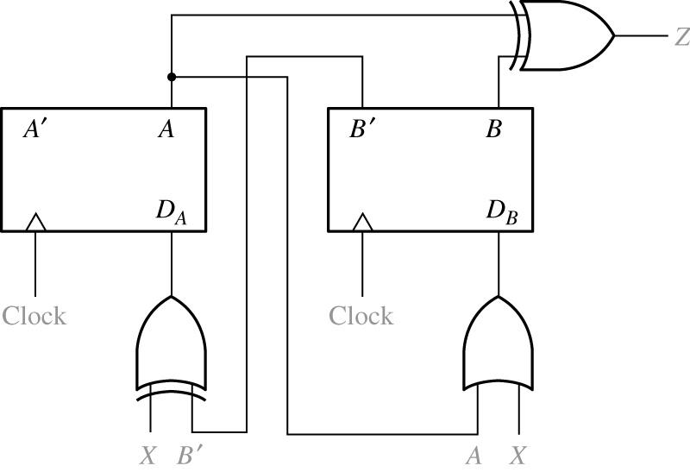
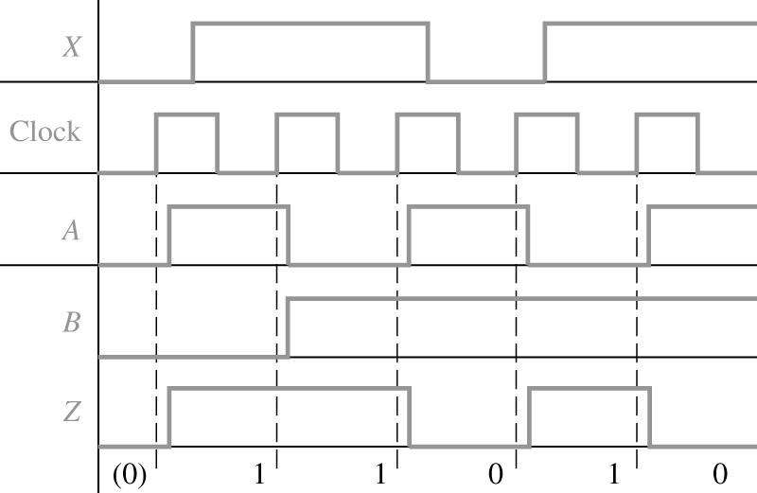
13.2 Analysis by Signal Tracing and Timing Charts
Figure 13-5: Moore Sequential Circuit to be Analyzed
X = 0 1 1 0 1
A = 0 1 0 1 0 1
B = 0 0 1 1 1 1
Z = (0) 1 1 0 1 0
Figure 13-6: Timing Chart for Figure 13-5
Initial value

Slide 9
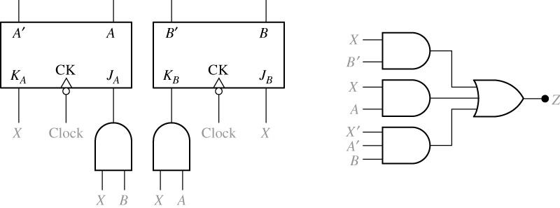
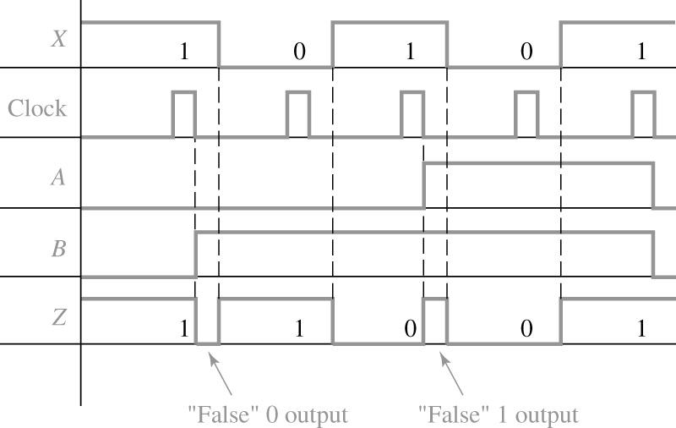
13.2 Analysis by Signal Tracing and Timing Charts
Figure 13-7: Mealy Sequential Circuit to be Analyzed
X = 1 0 1 0 1
A = 0 0 0 1 1 0
B = 0 1 1 1 1 0
Z = 1(0) 1 0(1) 0 1
(False outputs are indicated in parentheses)
Figure 13-8: Timing Chart for Circuit of Figure 13-7

Slide 10
13.3 State Table and Graphs
Determine the flip-flop input equations and the output equations from the circuit.
Derive the next-state equation for each flip-flop from its input equations, using one of the following relations:
3. Plot a next-state equations for the flip-flop.
4. Combine these maps to form the state table. Such a state table, which gives the next state of the flip-flops as a function of their present state and the circuit inputs, is frequently referred to as a transition table.
D flip-flop (13-1)
D-CE flip-flop (13-2)
T-flip-flop (13-3)
S-R flip-flop (13-4)
J-K flip-flop (13-5)

Slide 11
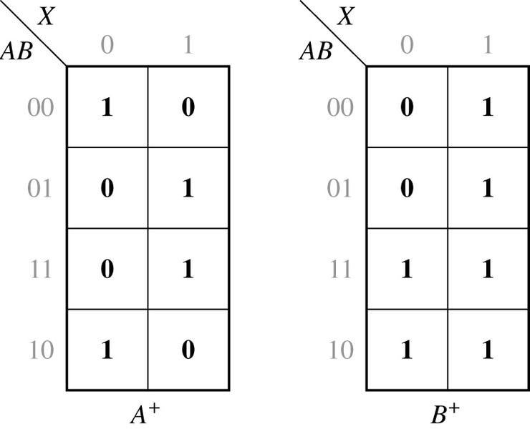
13.3 State Table and Graphs
1. The flip-flop input equations and output equation are
2. The next-state equations for the flip-flops are
3. The corresponding maps are
4. Combining these maps yields the transition table in Table 13-2(a), which gives the
next state of both flip-flops (A+,B+) as a function of the present state and input.
The output function Z is then added to the table. In this example, the output
depends only on the present state of the flip-flops and not on the input,so only a
single output column is required

Slide 12
13.3 State Table and Graphs
Table 13-2: Moore State Tables for Figure 13-5
00 01 11 10 | 01 00 11 01 11 11 01 | 0 1 0 1
Present State | Next state | Present Output(z)

Slide 13
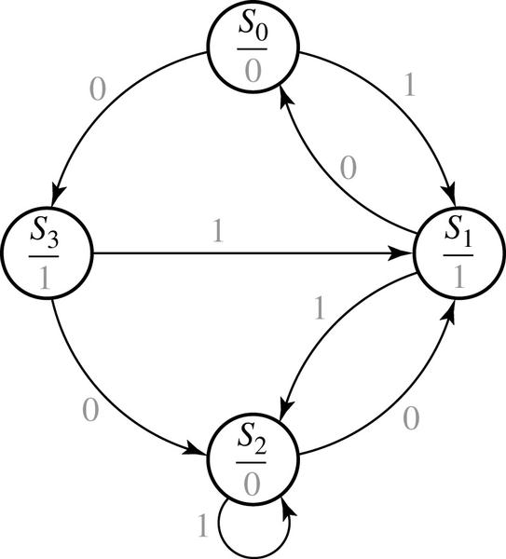
13.3 State Table and Graphs
Figure 13-9: Moore State Graph for Figure 13-5

Slide 14
13.3 State Table and Graphs
The state table and graph for the Mealy machine of Figure 13-7
The next-state and output equations for Figure 13-7 are

Slide 15
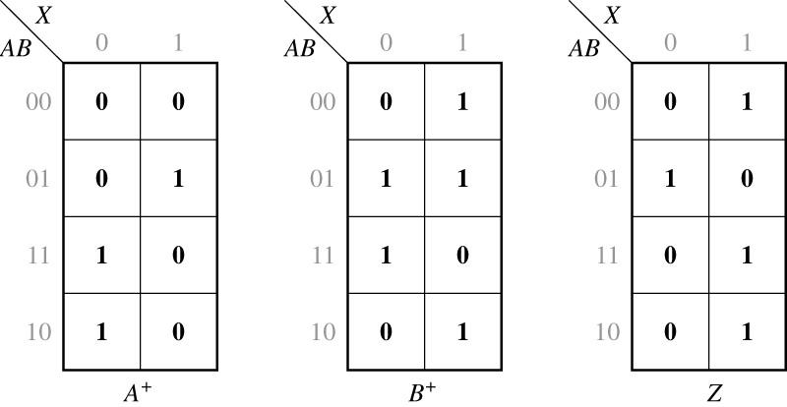
13.3 State Table and Graphs
Figure 13-10: The next-state and output maps for Figure 13-7

Slide 16
13.3 State Table and Graphs
Table 13-3: Mealy State Tables for Figure 13-7
Present State | Next state | Present Output(z)
00
01
11
10
00 01
01 11
11 00
10 01
0 1
1 0
0 1
0 1
1
0
1

Slide 17
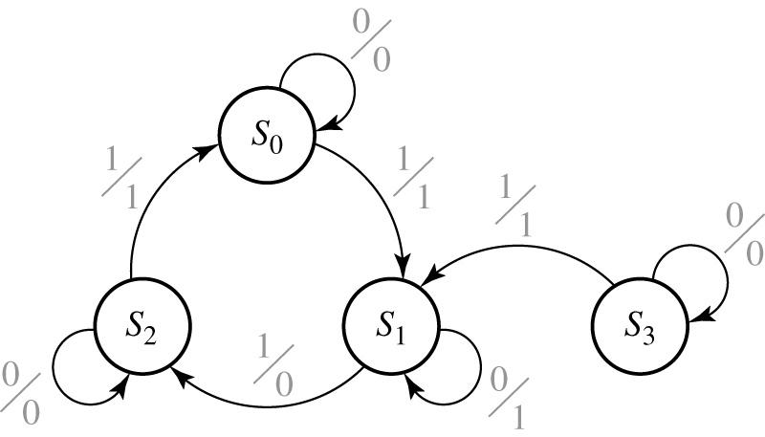
13.3 State Table and Graphs
Figure 13-11: Mealy State Graph for Figure 13-7
Input/output

Slide 18
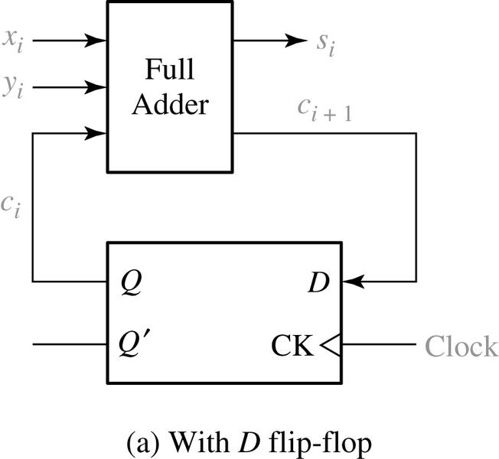
13.3 State Table and Graphs
Figure 13-12: Serial Adder
Output carry
0 0 0
0 0 1
0 1 0
0 1 1
1 0 0
1 0 1
1 1 0
1 1 1
0 0
0 1
0 1
1 0
0 1
1 0
1 0
1 1
Input carry
(b) Truth table

Slide 19
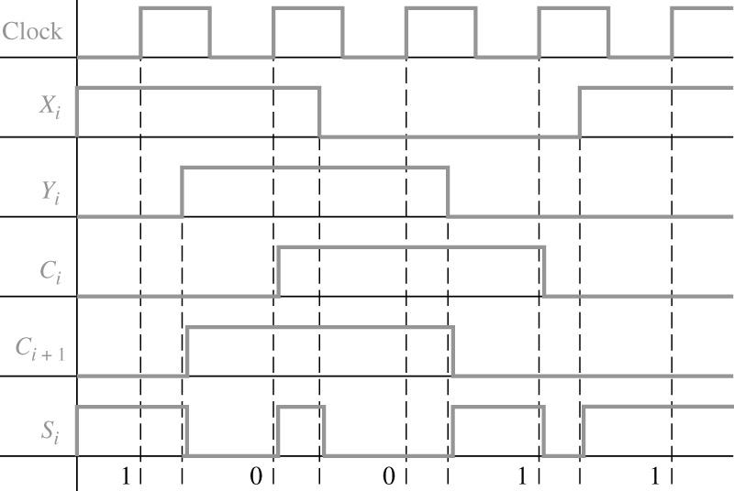
13.3 State Table and Graphs
Figure 13-13: Timing Diagram for Serial Adder
FF delay
FA delay

Slide 20
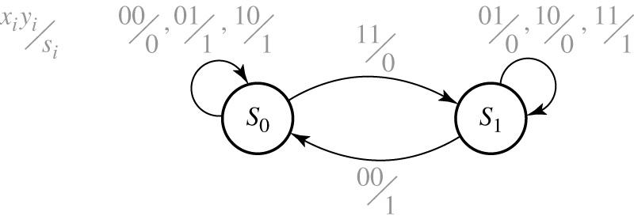
13.3 State Table and Graphs
Figure 13-14: State Graph for Serial Adder
S₀: input carry C_{i} = 0
S₁: input carry C_{i} = 1

Slide 21
13.3 State Table and Graphs
Table 13-4 A Mealy State table with two Inputs and two Outputs
Present State | Next state | Present Output (Z1 Z2)

Slide 22
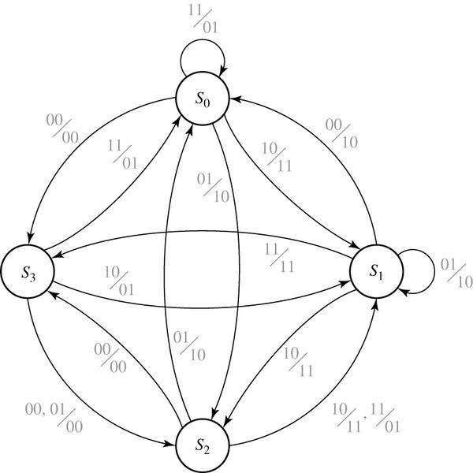
13.3 State Table and Graphs
Figure 13-15: State Graph for Table 13-4

Slide 23
13.3 State Table and Graphs
Construction and interpretation of Timing Chart
When constructing timing charts, note that a state change can only occur after the rising (or falling) edge of the clock, depending on the type of flip-flop used
The input will normally be stable immediately before and after the active clock edge.
For a Moore circuit, the output changes only when the state changes. But, for a Mealy circuit, the output can change when the input changes as well as when the state changes. A false may occur between the state changes and the time the input is changed to its new value. (In other words, if the state has changed to its next value, but the old input is still present, the output may be temporally incorrect.)
False outputs are difficult to determine from the state graph, so use either signal racing through the circuit or use the state table when constructing timing charts for Mealy circuit.
When using a Mealy state table for constructing timing charts, the procedure is as follows:
For the first input, read the present output and plot it.
Read the next state and plot it (following the active edge of the clock pulse).
Go to the row in the table which corresponds to the next state and read the output under the old input column and plot it.
Change to the next input and repeat step (a) (b) and ( c).
For Mealy circuits, the best time to read the output is just before the active edge of the clock, because the output should always be correct at that time.

Slide 24
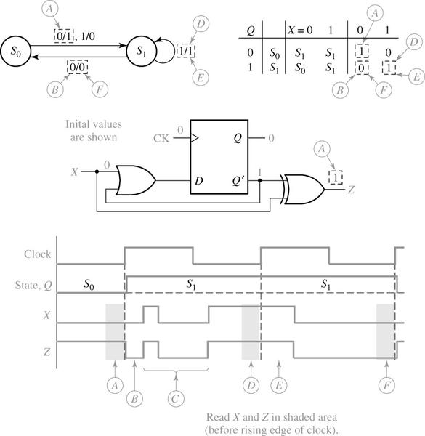
13.3 State Table and Graphs
Figure 13-16

Slide 25
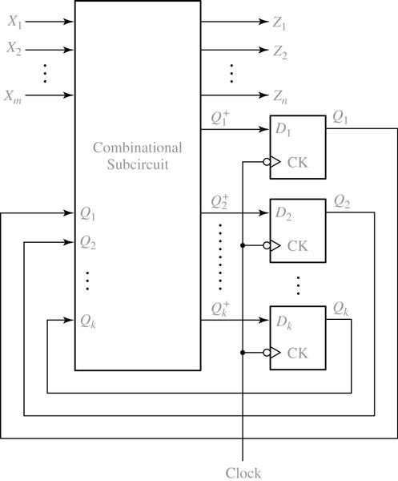
13.4 General Models for Sequential Circuit
Figure 13-17: General Model for Mealy Circuit Using Clocked D Flip-Flops

Slide 26
13.4 General Models for Sequential Circuit
.
.
.
n output functions
.
.
.
k next-state functions
The combinational sub-circuit realizes the n output functions and the k next-state functions, which serve as inputs to the D flip-flop.

Slide 27
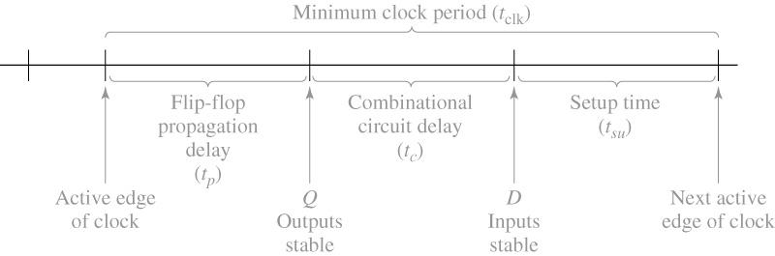
13.4 General Models for Sequential Circuit
Figure 13-18: Minimum Clock Period for a Sequential Circuit
where t_{x} is the time after the active clock edge at which the X inputs are stable

Slide 28
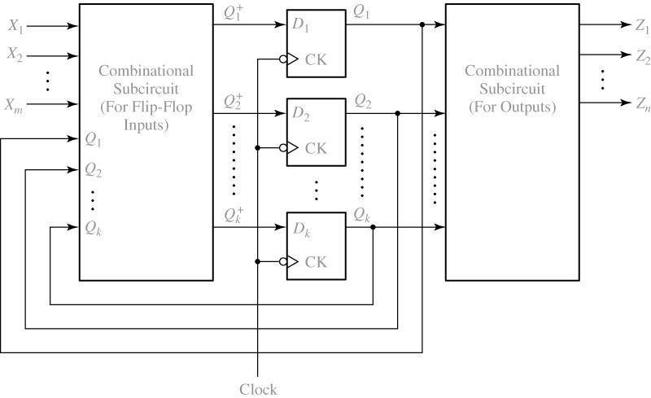
13.4 General Models for Sequential Circuit
Figure 13-19: General Model for Moore Circuit Using Clocked D Flip-Flops

Slide 29
13.4 General Models for Sequential Circuit
Table13-5 State Table with Multiple inputs and Outputs
Present
State
Next state
Present
Output(z)

